Slide 1
Statistics and probability
Shreyas M
B.Tech in ECE PES University Bangalore

Slide 2
Chapter Map
Section | Topic
1 | Introduction
2 | Range
3 | Mean deviation
4 | Variance
5 | Standard Deviation and Root Mean Square
6 | Coefficient of variance
7 | Basics of probability
8 | Types of events
9 | Axioms and Theorems on probability

Slide 3
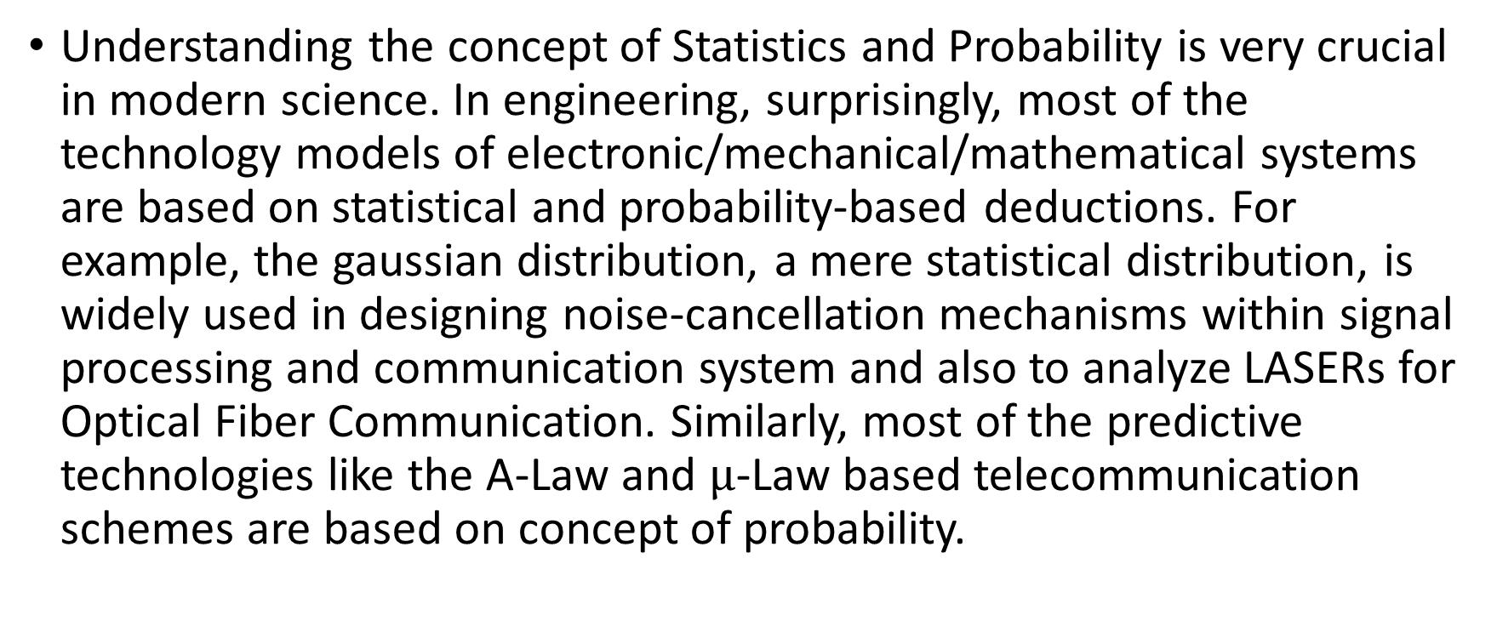
1 Introduction
Understanding the concept of Statistics and Probability is very crucial in modern science. In engineering, surprisingly, most of the technology models of electronic/mechanical/mathematical systems are based on statistical and probability-based deductions. For example, the gaussian distribution, a mere statistical distribution, is widely used in designing noise-cancellation mechanisms within signal processing and communication system and also to analyze LASERs for Optical Fiber Communication. Similarly, most of the predictive technologies like the A-Law and $μ$-Law based telecommunication schemes are based on concept of probability.

Slide 4
2 Range
Given a discrete set of random data the range of the values is defined as the difference between the highest possible value and the least possible value
Let us assume a series of samples of an voice signal where we have data on the values of instantaneous frequencies in Hertz
{ 312, 319.6 , 309.1, 351.4, 371.7, 312.4}
The maximum frequency is 371.7 Hertz and the minimum is 309.1 Hertz. The range of the person to whom this voice belongs can be defined as a set as [309.1 , 371.7] Hertz or as average of how much it varies with respect to his average frequency of voice.

Slide 5
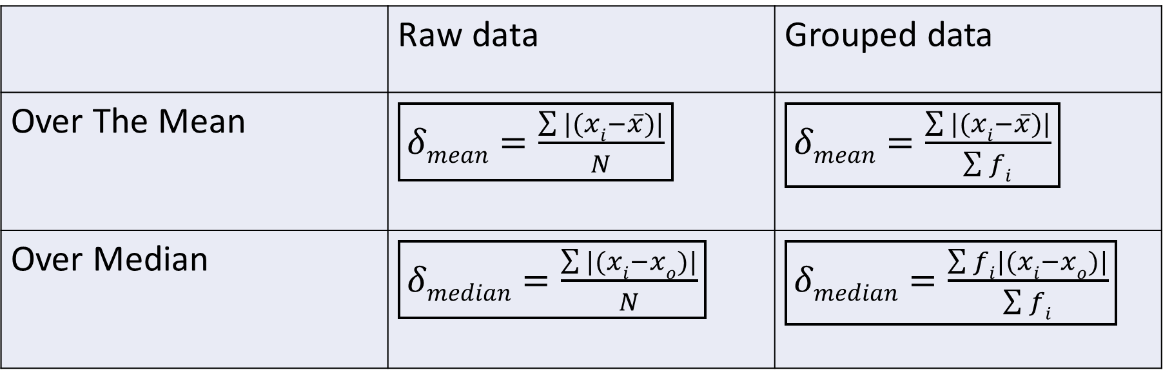

3 Mean deviation
As discussed earlier, this is one of the ways to measure the range. Let us consider the set of raw data as $x$ and its mean value as $\overline{x}$ and center-most value (Median) $xo$ Mean deviation is generally described in two ways
 | Raw data | Grouped data
Over The Mean | $\boxed{δmean=\frac{\sum{|(xi−}\overline{x})|}{N}}$ | $\boxed{δmean=\frac{\sum{|(xi−}\overline{x})|}{\sum{fi}}}$
Over Median | $\boxed{δmedian=\frac{\sum{|(xi−}xo)|}{N}}$ | $\boxed{δmedian=\frac{\sum{fi|(xi−}xo)|}{\sum{fi}}}$

Slide 6
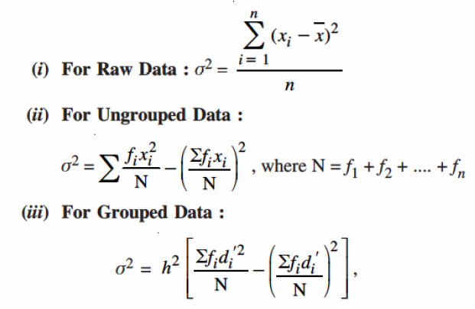

4 Variance
The measure of variation of values with respect to the mean value
For grouped data :
$$di=\frac{xi−A}{H}$$
$xi$ is middle point of class
A is assumed mean
H is height (width of each class)
It is suggested that we choose A
as the middle point of class with
highest f_{i}

Slide 7
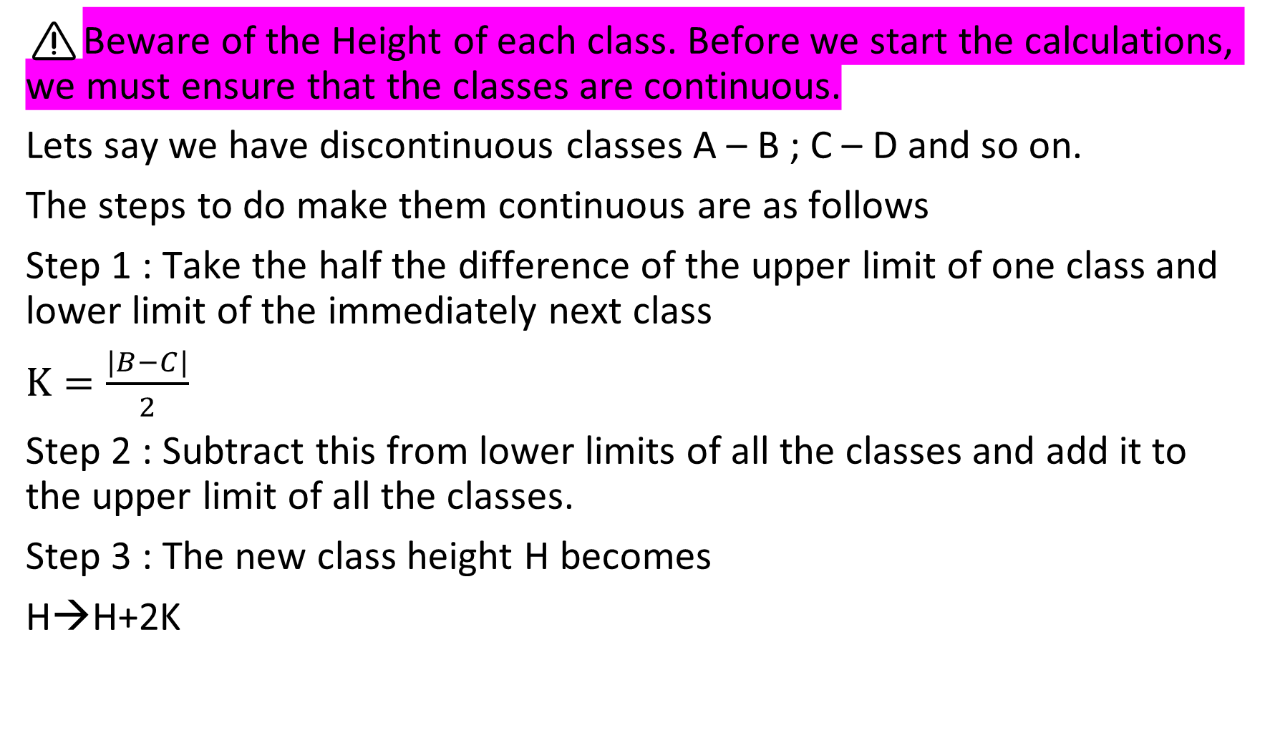
⚠️Beware of the Height of each class. Before we start the calculations, we must ensure that the classes are continuous.
Lets say we have discontinuous classes A – B ; C – D and so on.
The steps to do make them continuous are as follows
Step 1 : Take the half the difference of the upper limit of one class and lower limit of the immediately next class
$K=\frac{|B−C|}{2}$
Step 2 : Subtract this from lower limits of all the classes and add it to the upper limit of all the classes.
Step 3 : The new class height H becomes
H→H+2K

Slide 8
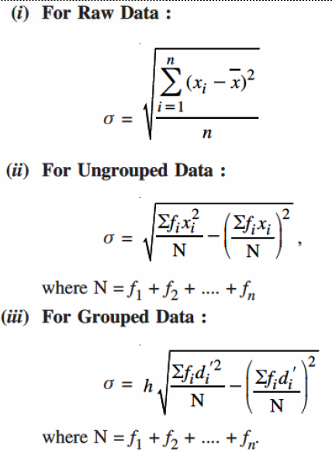
5 Standard Deviation
Standard deviation is the mean of square of variation of data about an arbitrary value assumed within range of the data. If the assumed value is the mean of the data itself then it is called “Root-Mean-Square” variation.

Slide 9
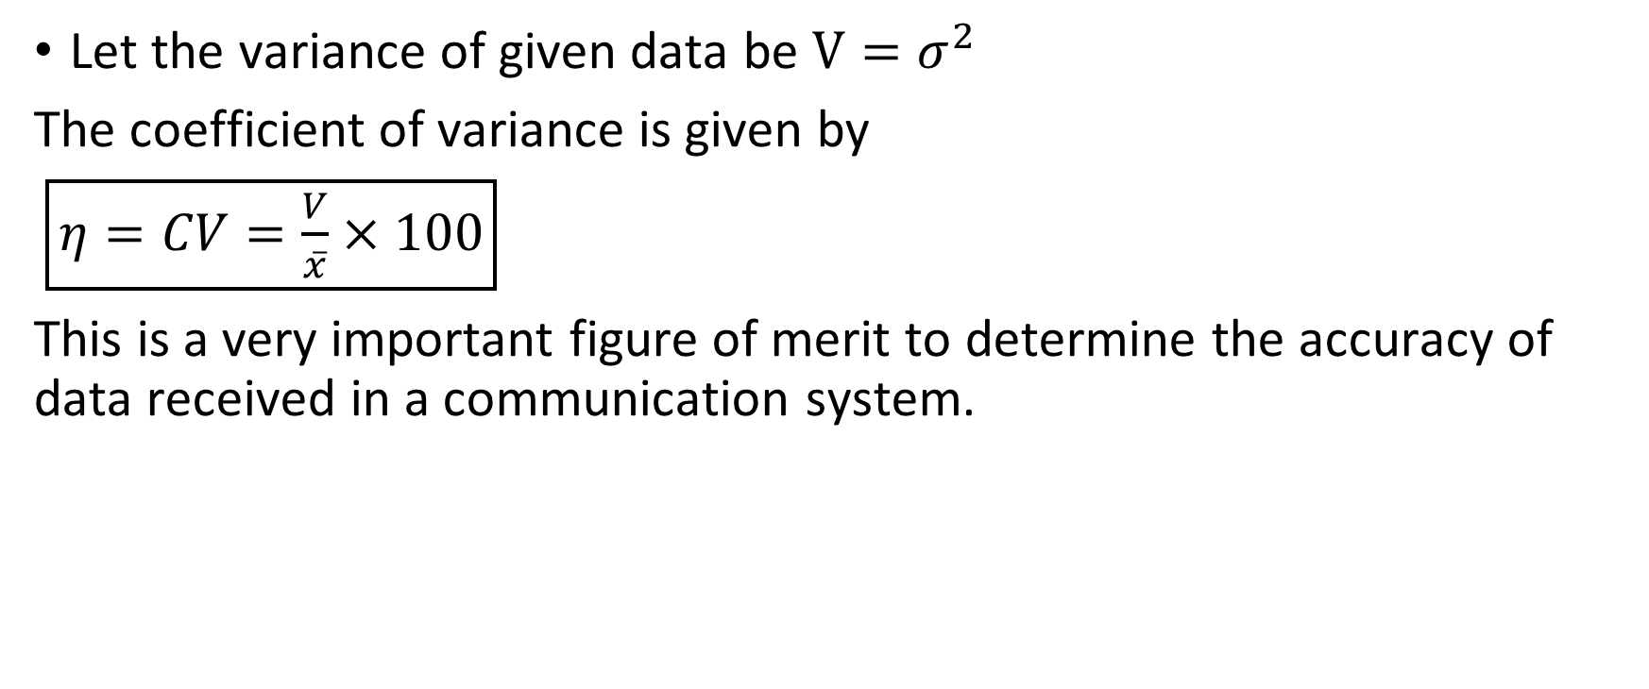
6 Coefficient of variance
Let the variance of given data be $V=σ^{2}$
The coefficient of variance is given by
$\boxed{η=CV=\frac{V}{\overline{x}}×100}$
This is a very important figure of merit to determine the accuracy of data received in a communication system.

Slide 10
7 Basics of probability
Now that we are familiar with real life application of probability, Before we get into understanding, we need to understand few basic terms.
Random experiment (aka trial) : Any activity conducted which result and well defined outcome. Ex: Rolling a die, Drawing a card at random, tossing a coin, etc.
Sample Space : The list of all the possible outcomes of a random experiment. Ex: Rolling a die can result in one of the outcomes from the set {1, 2, 3, 4, 5, 6}

Slide 11
8 Types of events
An event is the resultant occurrence of a trial. Ex: Heads showing up in coin toss is an event.
There are various types of events.
Simple : An event which has only one possible way of occurring (otherwise, compound or mixed)
Exhaustive : if occurrence of an event affects sample-space for the next trial
Favorable : Any case which favors the occurrence of an event
Mutually exclusive : Events which do not affect each other in any way whatsoever (Intersection of event space is void)

Slide 12
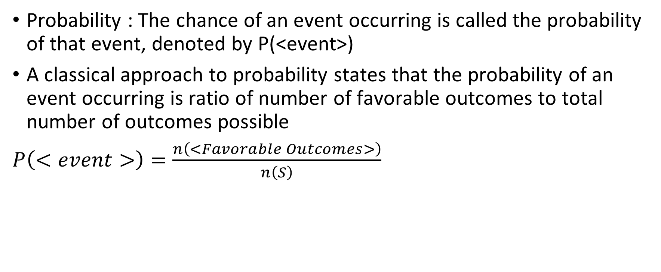
9 Axioms and Theorems on probability
Probability : The chance of an event occurring is called the probability of that event, denoted by P(<event>)
A classical approach to probability states that the probability of an event occurring is ratio of number of favorable outcomes to total number of outcomes possible
$P\left(<event>\right)=\frac{n\left(<Favorable Outcomes>\right)}{n\left(S\right)}$

Slide 13
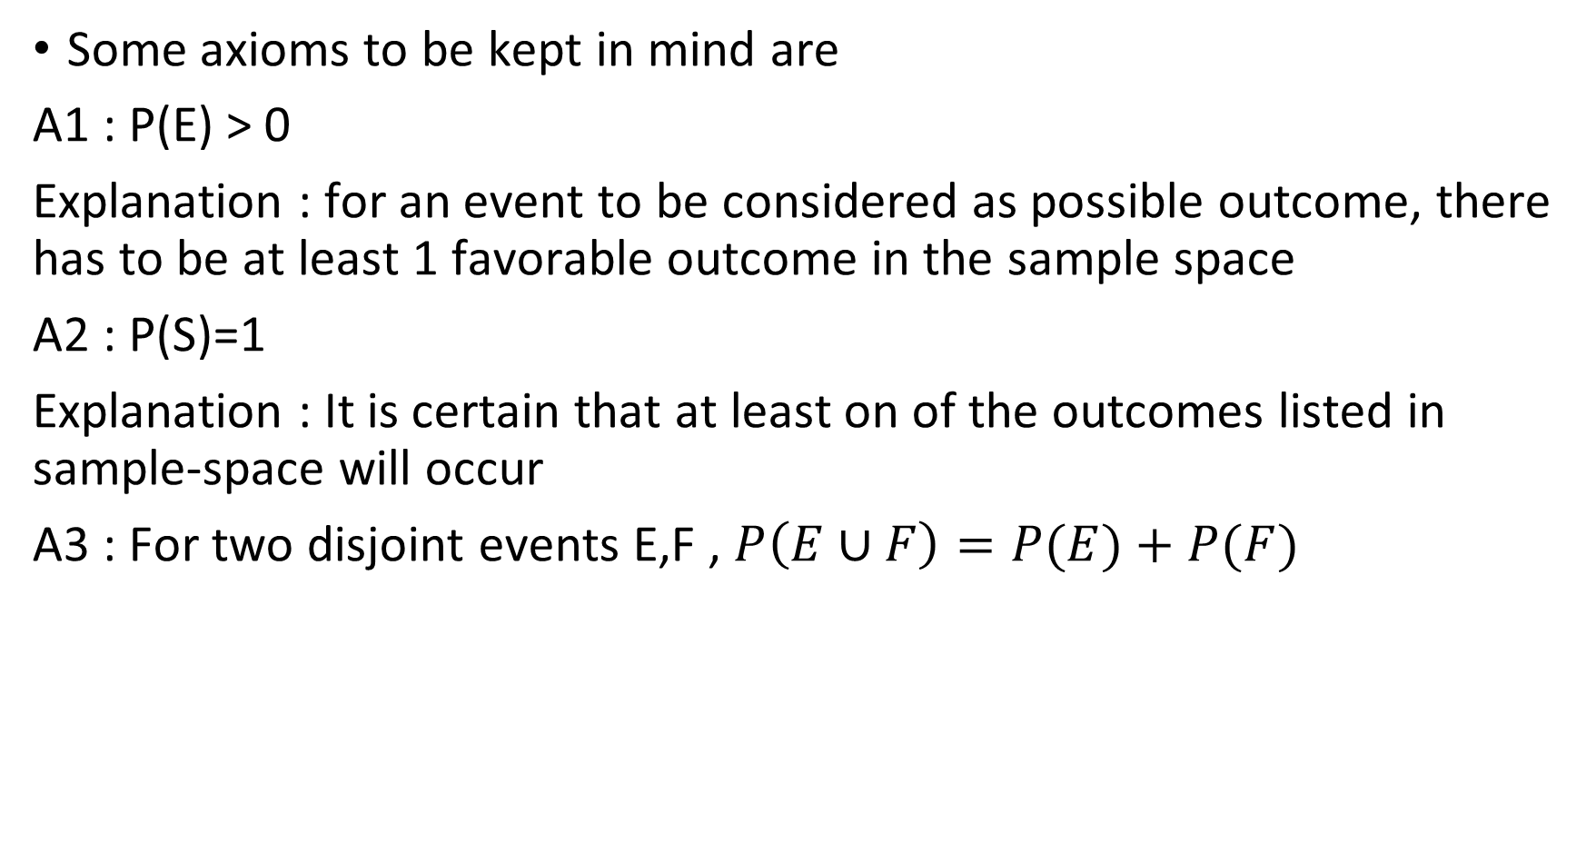
Some axioms to be kept in mind are
A1 : P(E) > 0
Explanation : for an event to be considered as possible outcome, there has to be at least 1 favorable outcome in the sample space
A2 : P(S)=1
Explanation : It is certain that at least on of the outcomes listed in sample-space will occur
A3 : For two disjoint events E,F , $P\left(E∪F\right)=P(E)+P(F)$

Slide 14
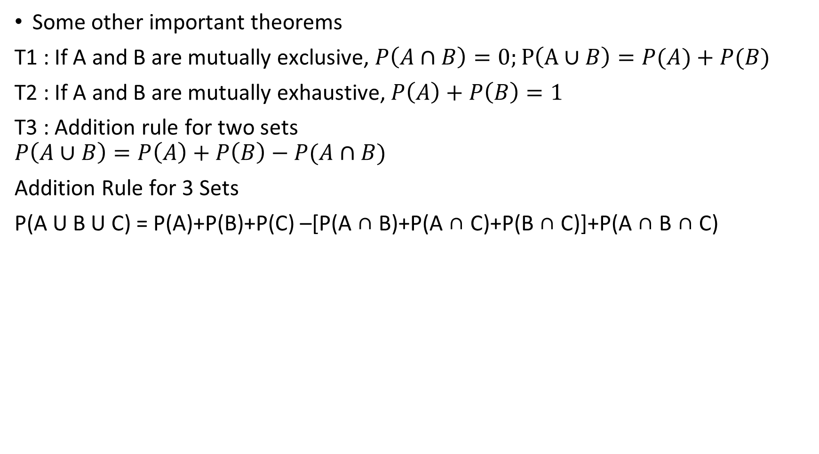
Some other important theorems
T1 : If A and B are mutually exclusive, $P\left(A∩B\right)=0;P\left(A∪B\right)=P(A)+P(B)$
T2 : If A and B are mutually exhaustive, $P\left(A\right)+P\left(B\right)=1$
T3 : Addition rule for two sets
$$P\left(A∪B\right)=P\left(A\right)+P\left(B\right)−P(A∩B)$$
Addition Rule for 3 Sets
P(A U B U C) = P(A)+P(B)+P(C) –[P(A ∩ B)+P(A ∩ C)+P(B ∩ C)]+P(A ∩ B ∩ C)

Slide 15
Thank you
Shreyas M
B.Tech in ECE PES University Bangalore

